Slide 1
Co-localization Methods
Fan Wang
March 28 2025

Slide 2
Outline
Introduction to Colocalization
Challenges
Overview of Classical Methods
Bayesian Colocalization approaches

Slide 3
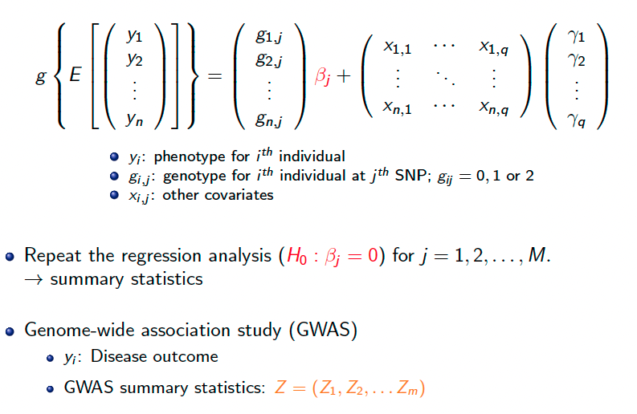
Introduction - Genetic Association Analysis

Slide 4
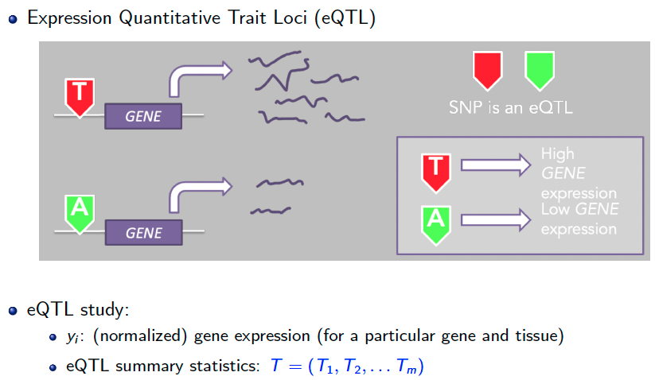
Introduction - Genetic Association Analysis

Slide 5
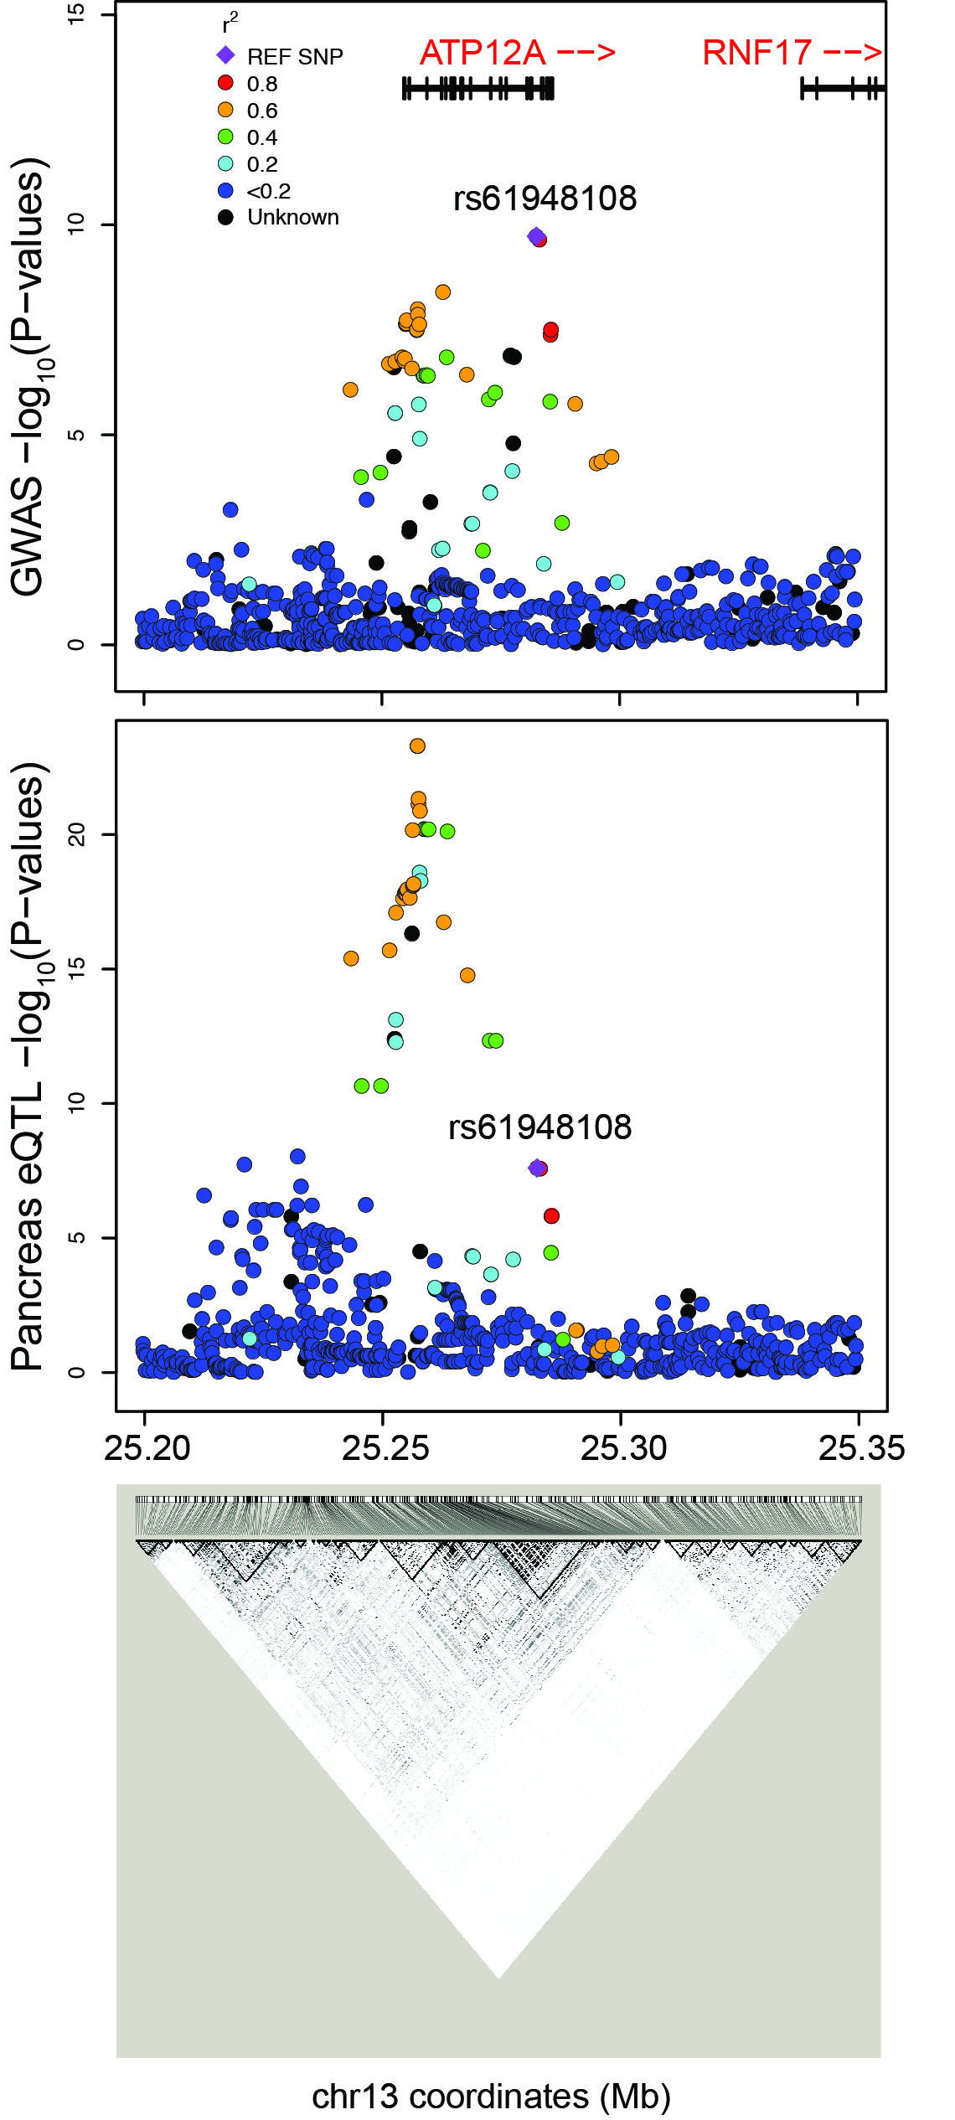
Visualizing GWAS and eQTLs
Colocalization analysis:
We want to test whether eQTL p-values and GWAS p-values have
similar/overlapping pattern at the set of same SNPs.
MI~SNP
E_{P}~SNP

Slide 6
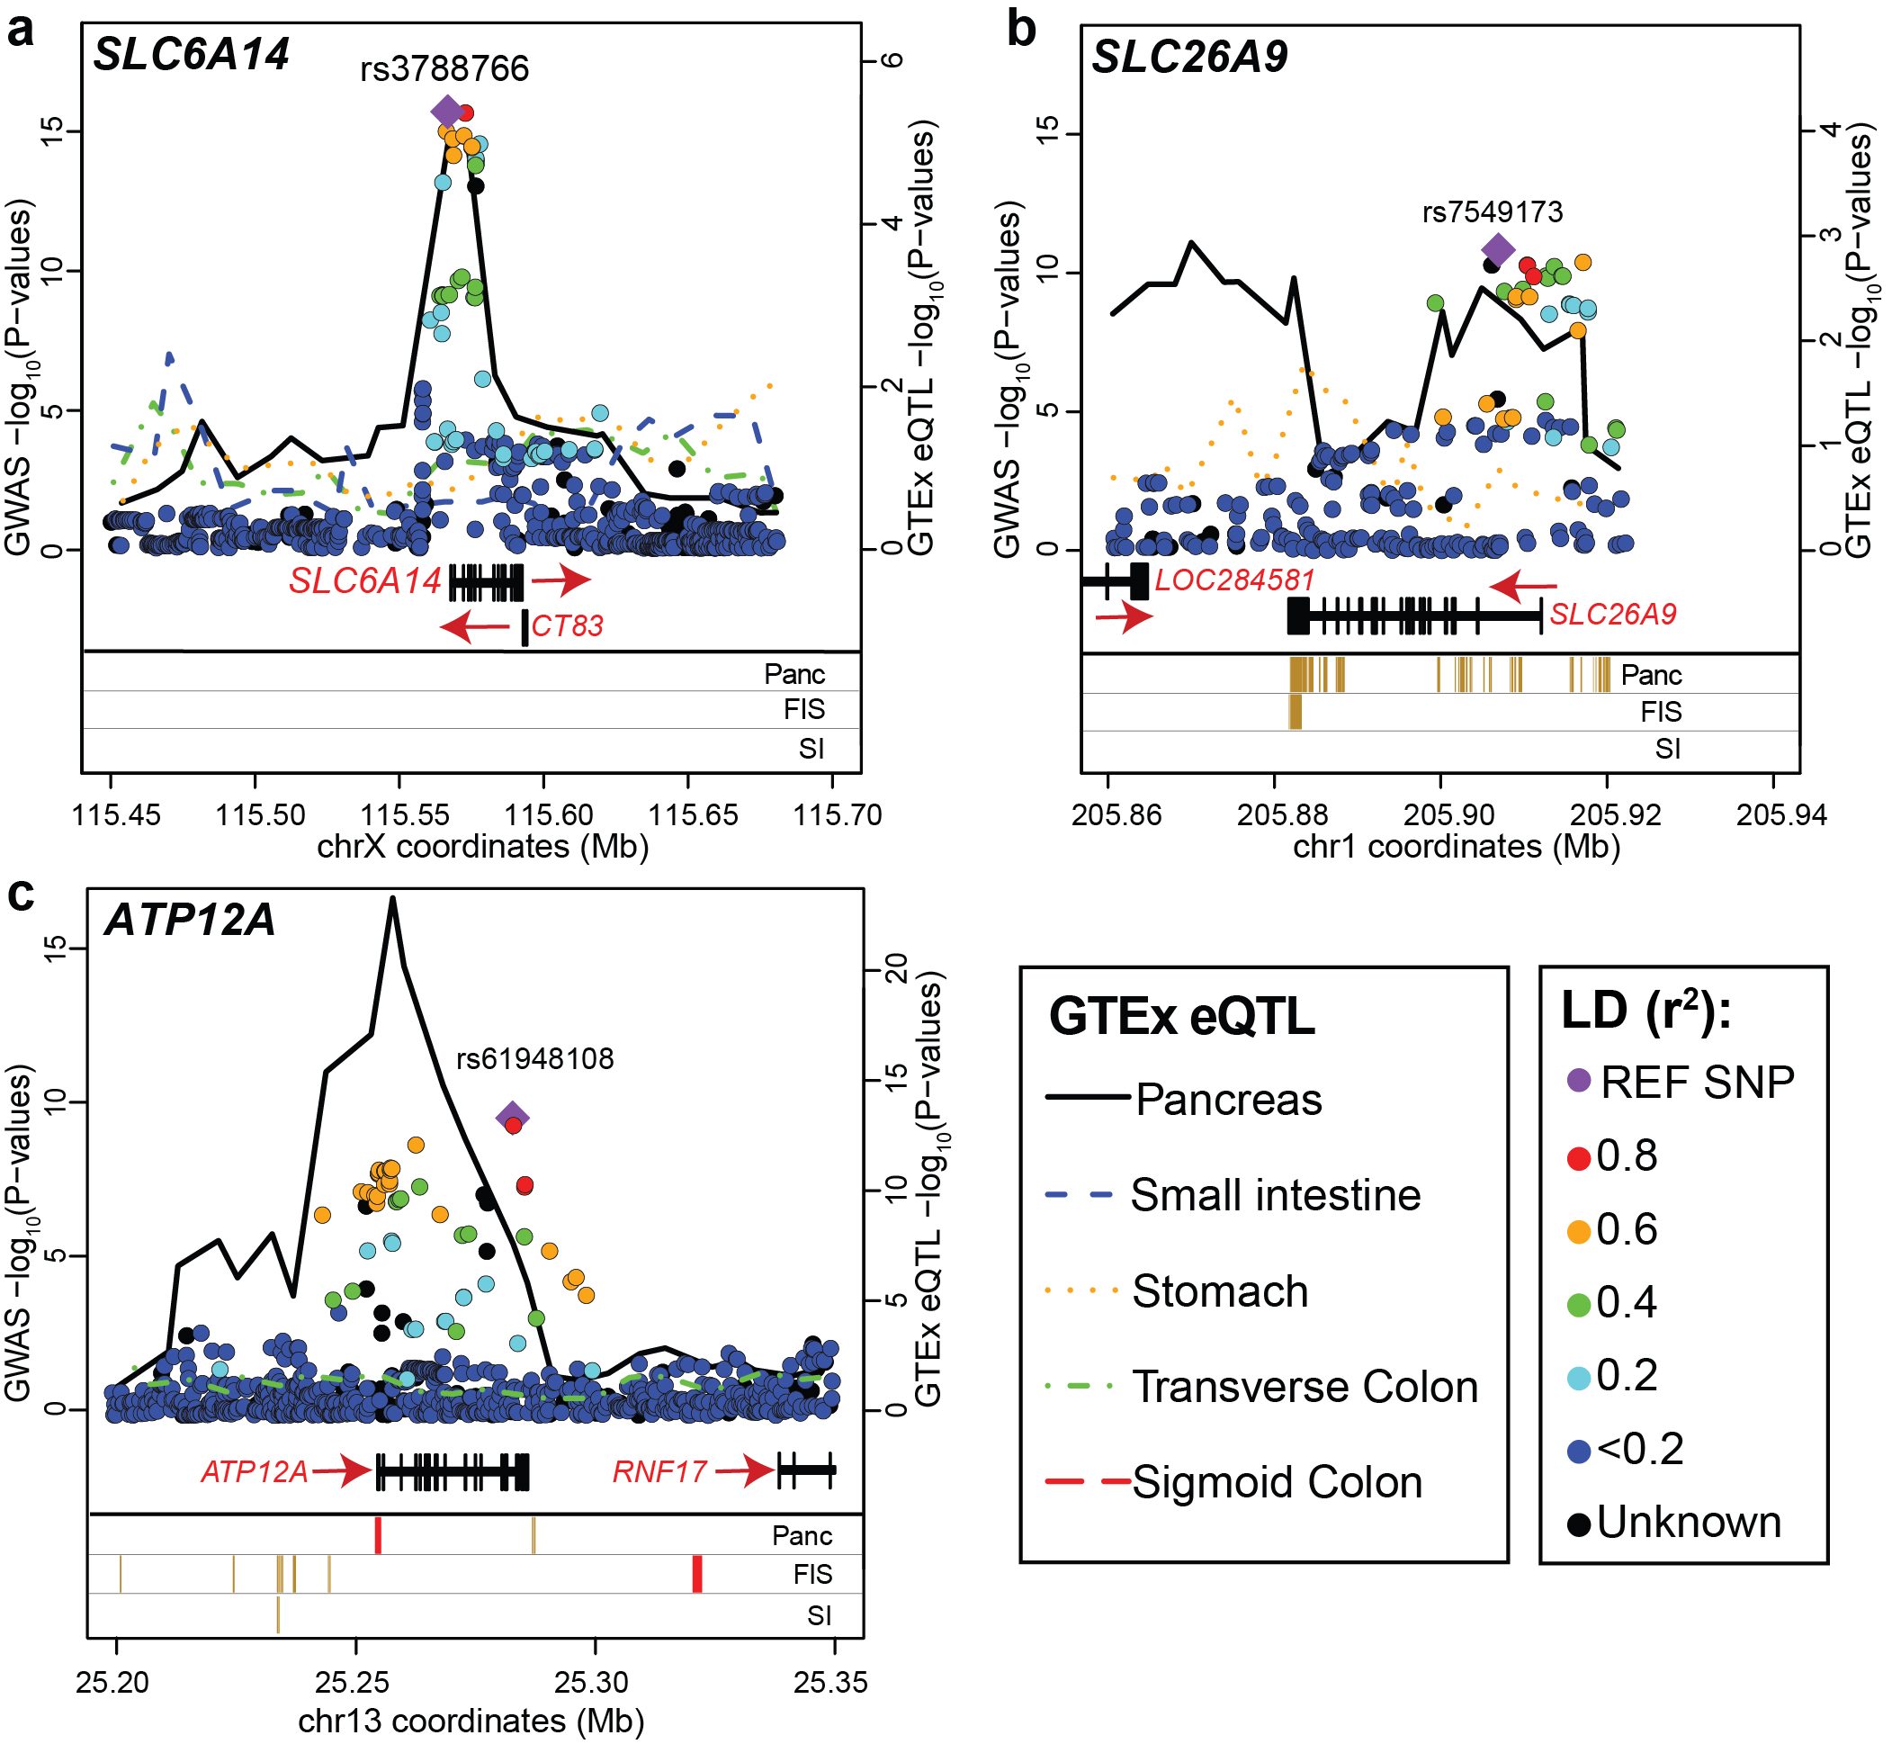

Slide 7
Different GWAS-eQTL Colocalization Scenarios | Illustration (red: GWAS, blue: eQTL)
Alter1: ONE GWAS SNP, and ONE eQTL
Alter2: The eQTL peak overlapped with the higher GWAS peak
Alter3: The eQTL peak overlapped with the lower GWAS peak

Slide 8
Different GWAS-eQTL Colocalization Scenarios | Illustration (red: GWAS, blue: eQTL)
Alter4: The non-overlapped eQTL peak is lower than the GWAS peak
Alter5: The non-overlapped eQTL peak is higher than the GWAS peak
Alter6: TWO overlapping GWAS SNPs and eQTLs

Slide 9
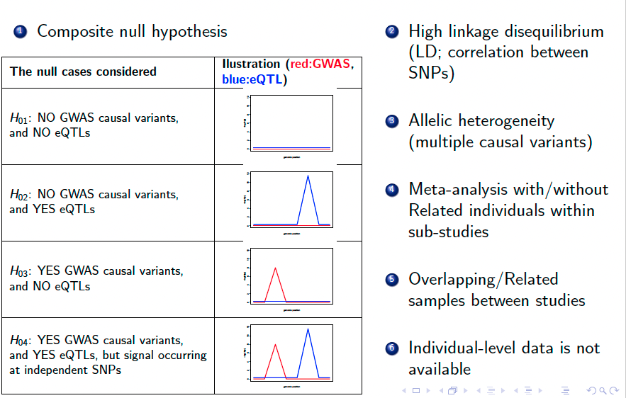
Challenges

Slide 10
Several Methods to integrate GWAS and eQTL Data
Bayesian approaches aim to identify shared causal variants contributes to both the disease outcome and gene expression variation.
COLOC , eCAVIAR, GWAS-PW.etc.
Frequentist-based methods:
Methods that impute gene expression based on a reference, and then associate imputed expression with the trait^{1,2}
PrediXcan and TWAS
Integration methods based on Mendelian randomization
SMR, SMR-multi
Overlapping pattern:
Simple Sum2

Slide 11
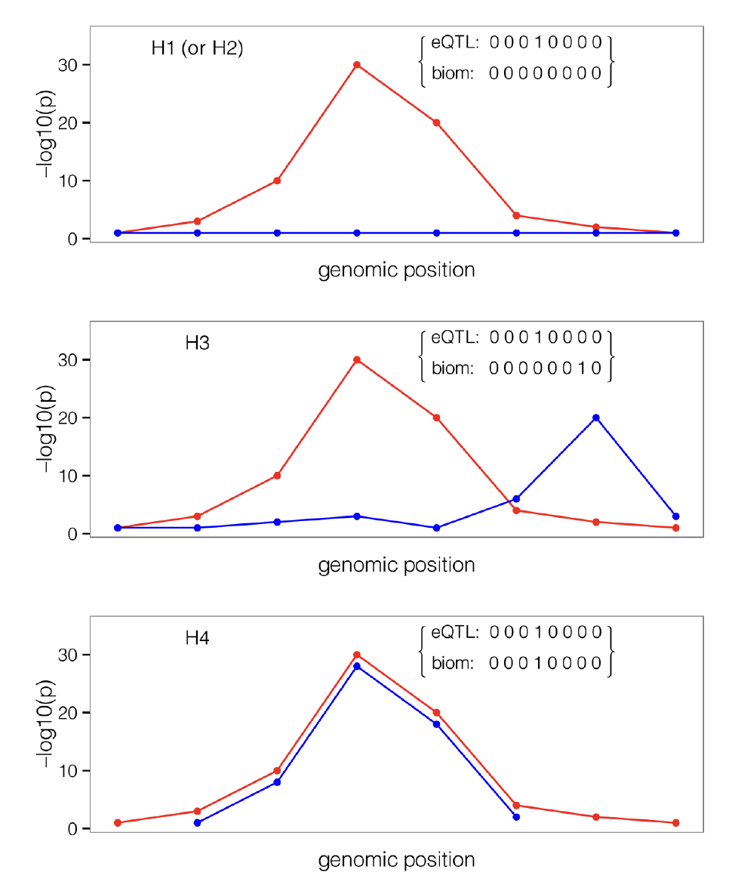
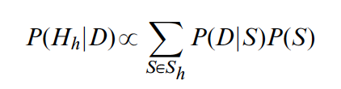
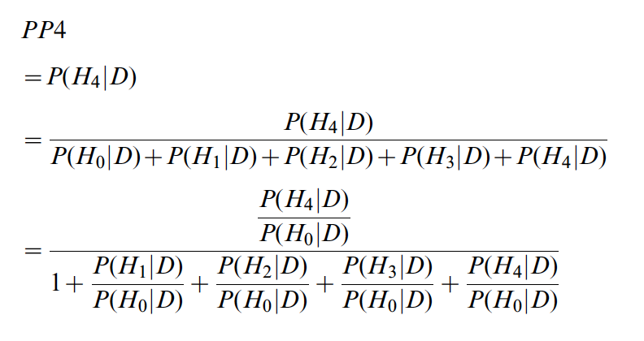
COLOC
Calculates posterior probability for 5 cases (from H0 to H4)
The support in the data for one alternative hypothesis versus the null hypothesis.

Slide 12
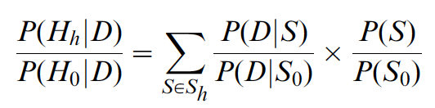
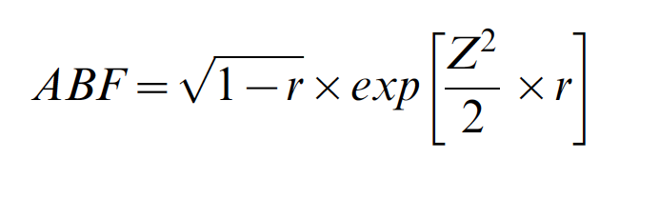
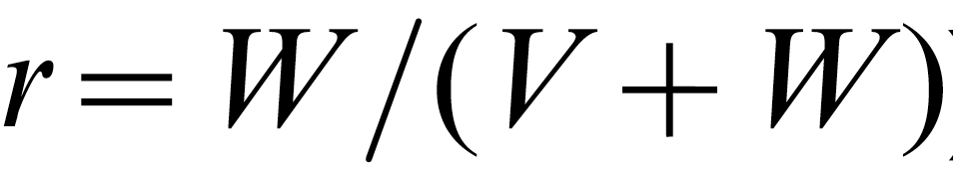
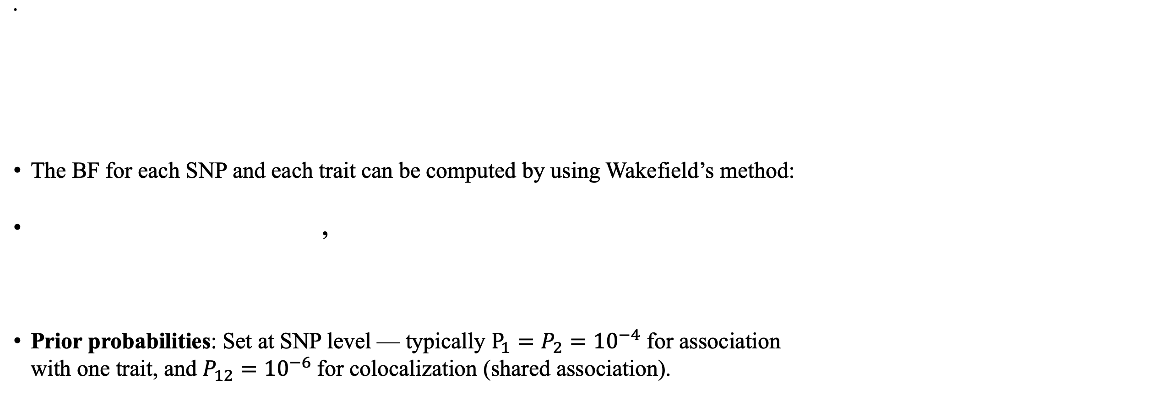
COLOC
The BF for each SNP and each trait can be computed by using Wakefield’s method:
,
Prior probabilities: Set at SNP level — typically $P_{1}=P_{2}={10}^{−4}$ for association with one trait, and $P_{12}={10}^{−6}$for colocalization (shared association).
Bayes Factor
Prior Odds
where
is the ratio of the variance of the prior and total variance.

Slide 13
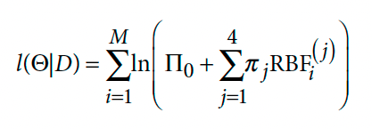
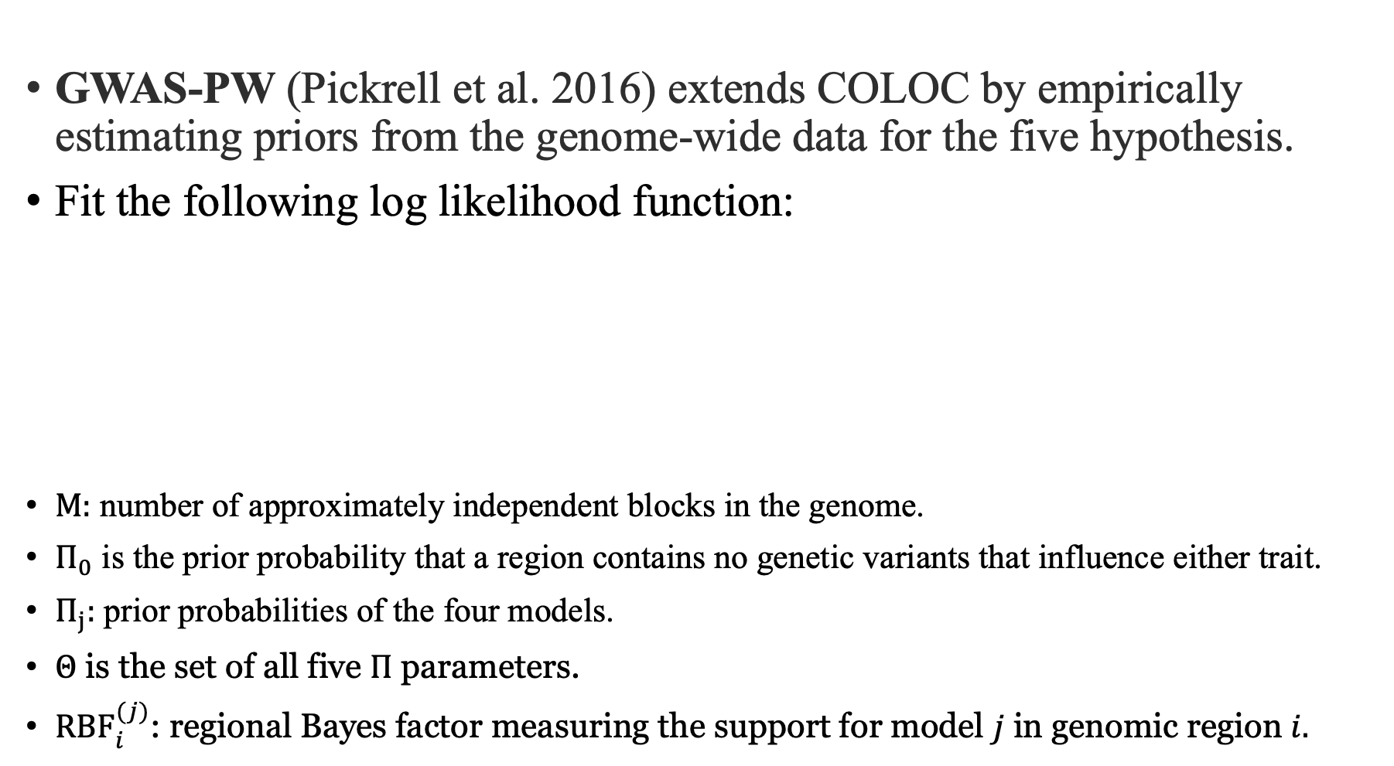
GWAS-PW
GWAS-PW (Pickrell et al. 2016) extends COLOC by empirically estimating priors from the genome-wide data for the five hypothesis.
Fit the following log likelihood function:
$M:$ number of approximately independent blocks in the genome.
$Π_{0}$ is the prior probability that a region contains no genetic variants that influence either trait.
$Π_{j}:$ prior probabilities of the four models.
$Θ$ is the set of all five $Π$ parameters.
${RBF}_{i}^{(j)}$: regional Bayes factor measuring the support for model $j$ in genomic region $i.$

Slide 14
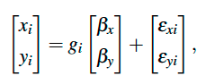
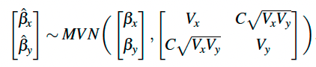
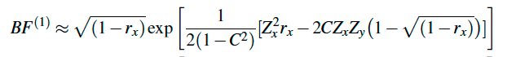
Dealing with Sample Relatedness
GWAS-PW uses a multivariate linear regression model:
The estimated effect size:
,
where C is Phenotypic correlation.
By placing a multivariate normal prior on the effect size,

Slide 15
Further Issues about GWAS-PW
Advantage of GWAS-PW (and COLOC):
Quick computation by Approximate Bayes Factor without iterative computation scheme (such as Markov Chain Monte Carlo) is required.
Distinguished evidence for non-colocalization.(H0-H4)
Deficiency of GWAS-PW (and COLOC):
Single causal variant assumption
→ Reduce accuracy of results with presence of allelic heterogeneity
Colocalization is concluded using a recommended value for the posterior colocalization probability (i.e. 0.8)
→ Inclusive result when PP4 are not significantly higher than PP1/PP2/PP3

Slide 16
ECAVIAR (Hormozdiari et al. 2016)
Simultaneously performing fine-mapping for GWAS and eQTL studies by considering almost all combinations of causal status between SNPs
Estimate the posterior probability that the same variant is causal in both studies :
Advantage:
Higher true positive rate compared to COLOC when multiple variants are causal in a locus with low LD.
Limitations:
Computation can be very long when number of SNPs is huge
Impose an assumption on the maximum number of causal SNPs in a locus(six)
The posterior probability of co-localization will be averaged across several variants in high LD, resulting in ambiguous colocalization conclusions.

Slide 17
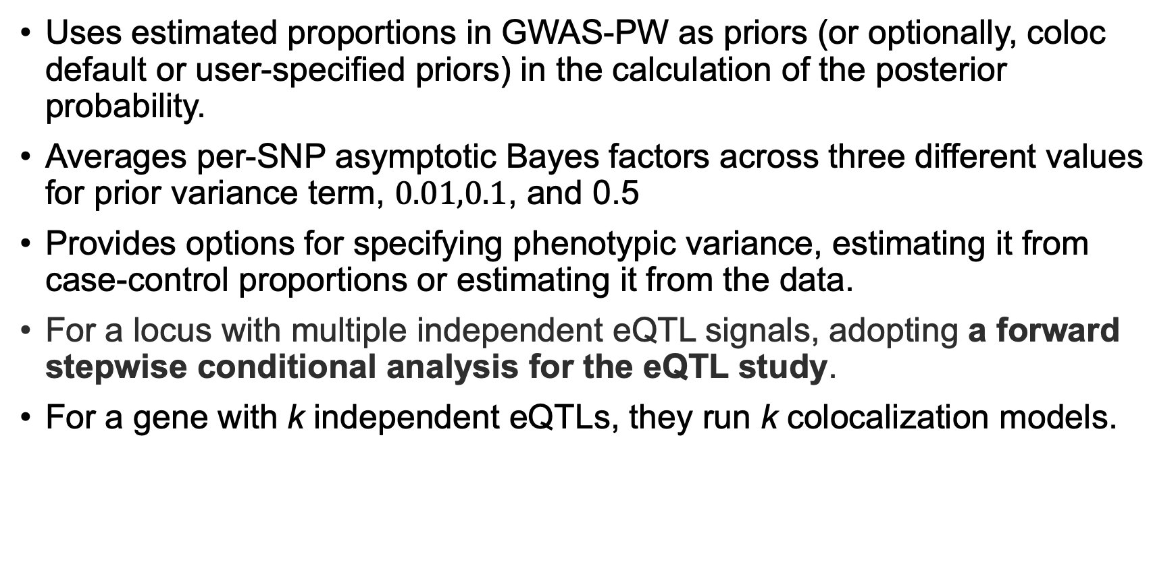
COLOC2 (Dobbyn et al. 2017)
Uses estimated proportions in GWAS-PW as priors (or optionally, coloc default or user-specified priors) in the calculation of the posterior probability.
Averages per-SNP asymptotic Bayes factors across three different values for prior variance term, $0.01,0.1$, and 0.5
Provides options for specifying phenotypic variance, estimating it from case-control proportions or estimating it from the data.
For a locus with multiple independent eQTL signals, adopting a forward stepwise conditional analysis for the eQTL study.
For a gene with k independent eQTLs, they run k colocalization models.

Slide 18
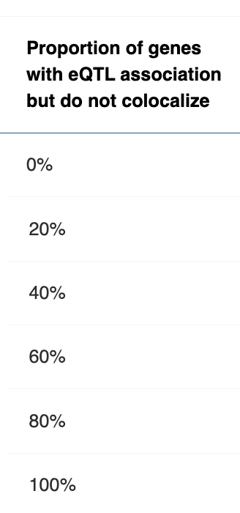
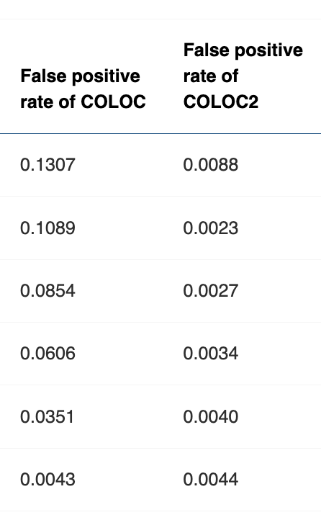
COLOC2
Simulation with 500 genes (Wang et al. 2021):
The false positive rate of COLOC2 is controlled after implementing GWAS-PW where the posterior probability is calculated based on the likelihood of all genes.
The posterior probability of COLOC needs to be modified to account for multiple hypothesis testing by adjusting the prior probability and other factors in the calculation of false positive report probability (FPRP) (Wacholder et al. 2024).

Slide 19
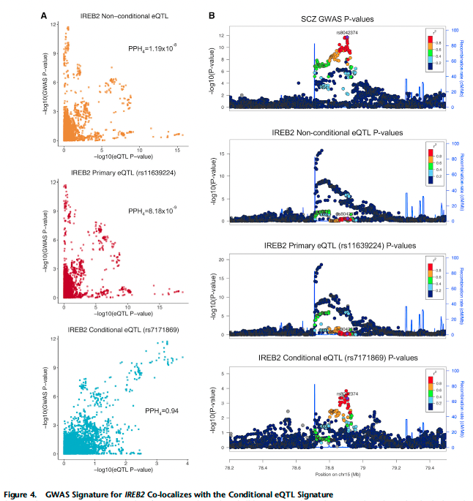
GWAS signature for IREB2 Colocalizes with the Conditional eQTL signature.

Slide 20
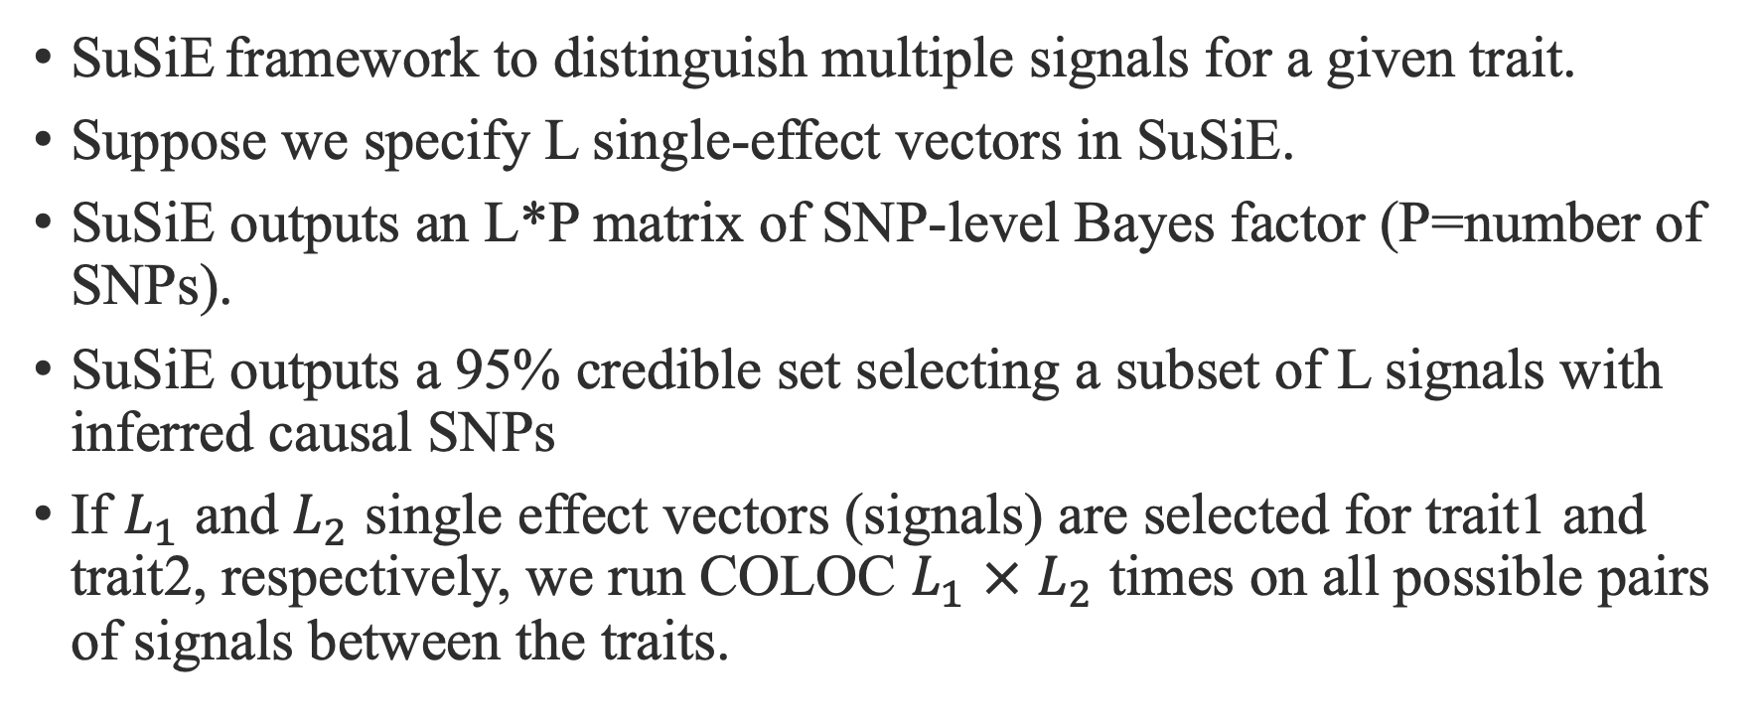
SuSiE-COLOC
SuSiE framework to distinguish multiple signals for a given trait.
Suppose we specify L single-effect vectors in SuSiE.
SuSiE outputs an L*P matrix of SNP-level Bayes factor (P=number of SNPs).
SuSiE outputs a 95% credible set selecting a subset of L signals with inferred causal SNPs
If $L_{1}$ and $L_{2}$ single effect vectors (signals) are selected for trait1 and trait2, respectively, we run COLOC $L_{1}$ $×$ $L_{2}$ times on all possible pairs of signals between the traits.

Slide 21
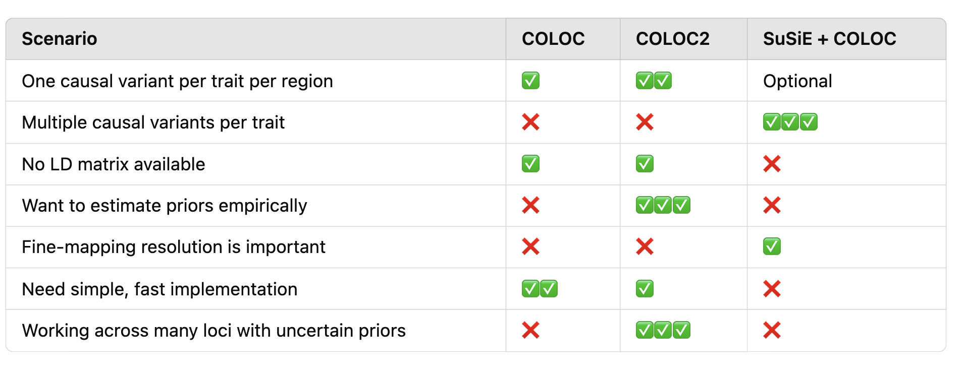
Which test should we use?

Slide 22
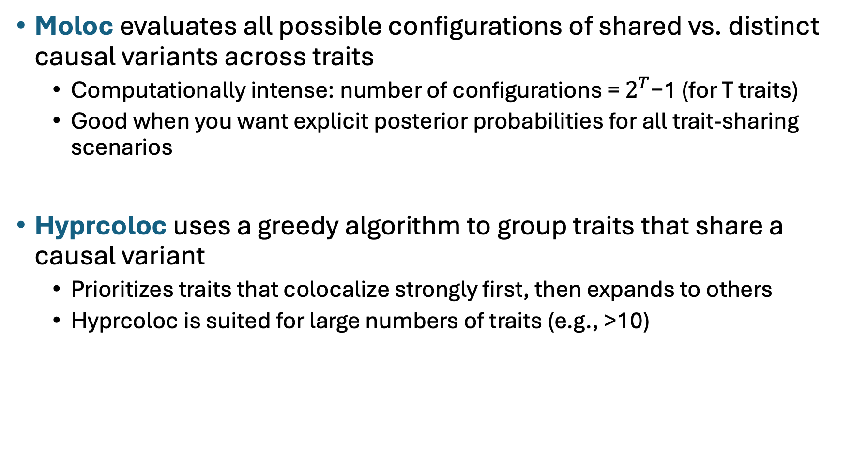
Extensions to Multi-Trait Colocalization
Moloc evaluates all possible configurations of shared vs. distinct causal variants across traits
Computationally intense: number of configurations = $2^{T}$−1 (for T traits)
Good when you want explicit posterior probabilities for all trait-sharing scenarios
Hyprcoloc uses a greedy algorithm to group traits that share a causal variant
Prioritizes traits that colocalize strongly first, then expands to others
Hyprcoloc is suited for large numbers of traits (e.g., >10)

Slide 23
Further Issues
eCAVIAR evaluates multiple causal configurations but is computationally intensive with many SNPs.
SuSiE-COLOC reduces complexity but still requires L₁ × L₂ coloc runs.
Reduced power when there is high LD
Few formal corrections for multiple hypotheses across loci.
Posterior probabilities (e.g., PPH4) must be interpreted with caution in genome-wide scans.
Adjusting priors using false positive report probability (FPRP) to control for multiple testing.

